Slide 1
DDOS Prevention
System using
AWS -
Serverless-Architecture
Final Year Project
Stage-1

Slide 2

Project Guide -
Prof. Noshir Z. Tarapore
Group Members -
Chanakya Patil - 07
202000542
Aryan Deshmukh - 08
202000584
Anamay Brahme - 12
202000702
Asad Vathare - 14
202000966
Vishwakarma University

Slide 3
Table of contents
01 What is DDOS? →
02 What is AWS and it’s Serverless Architecture? →
03 The Main Idea and Need for Prevention →
04 Proposed Design →
05 Working of Implementation →
06 Future Scope →
07 TimeLine →
08 Demo →

Slide 4
01
What is a DDOS Attack? →

Slide 5

Definition: A Distributed Denial of Service (DDoS) attack is a malicious act where multiple compromised devices flood a target system or network with excessive traffic, rendering it unable to function properly or respond to legitimate user requests.
Objective: The primary goal of a DDoS attack is to disrupt the availability and accessibility of a target's online services or website, causing inconvenience, financial losses, or even damaging its reputation.
Methodology: DDoS attacks typically utilize a network of compromised devices, often called a botnet, to generate an overwhelming amount of traffic. These devices can include computers, servers, IoT devices, or even smartphones that have been infected with malware.
Impact: DDoS attacks can have severe consequences, including downtime, decreased productivity, customer dissatisfaction, and potential loss of revenue. They can also serve as a diversionary tactic, allowing attackers to carry out other malicious activities while the target is preoccupied with mitigating the attack.

Slide 6
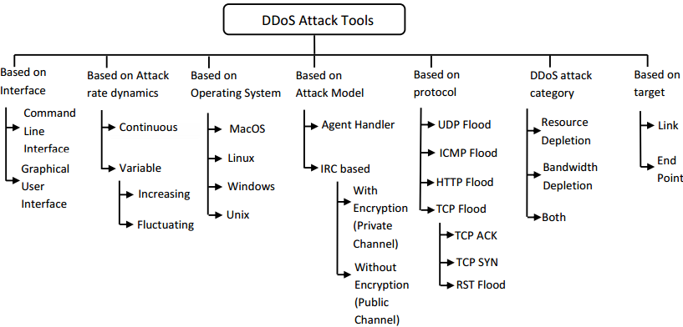

Slide 7
02
What is AWS and it’s Serverless Architecture? →

Slide 8

AWS, or Amazon Web Services, is a cloud computing platform provided by Amazon.
It offers a wide range of services for computing, storage, databases, networking, and more.
With AWS, businesses and individuals can access and utilize these services on-demand, paying only for what they use.
It provides a global network of data centers for deploying applications worldwide.
AWS has become a popular choice for organizations to build, host, and manage their applications and infrastructure in a scalable and cost-effective manner.

Slide 9

AWS Serverless Architecture is a way of building applications without worrying about managing servers.
Instead of dealing with the complexities of server setup and maintenance, developers can focus on writing code to create their application's functionality.
With AWS Serverless Architecture, developers use a service called AWS Lambda.
They upload their code to Lambda and specify when that code should be executed. Lambda takes care of running the code whenever specific events happen, such as when data changes or when an action is triggered.

Slide 10
03
The Main Idea and
Need for Prevention →

Slide 11
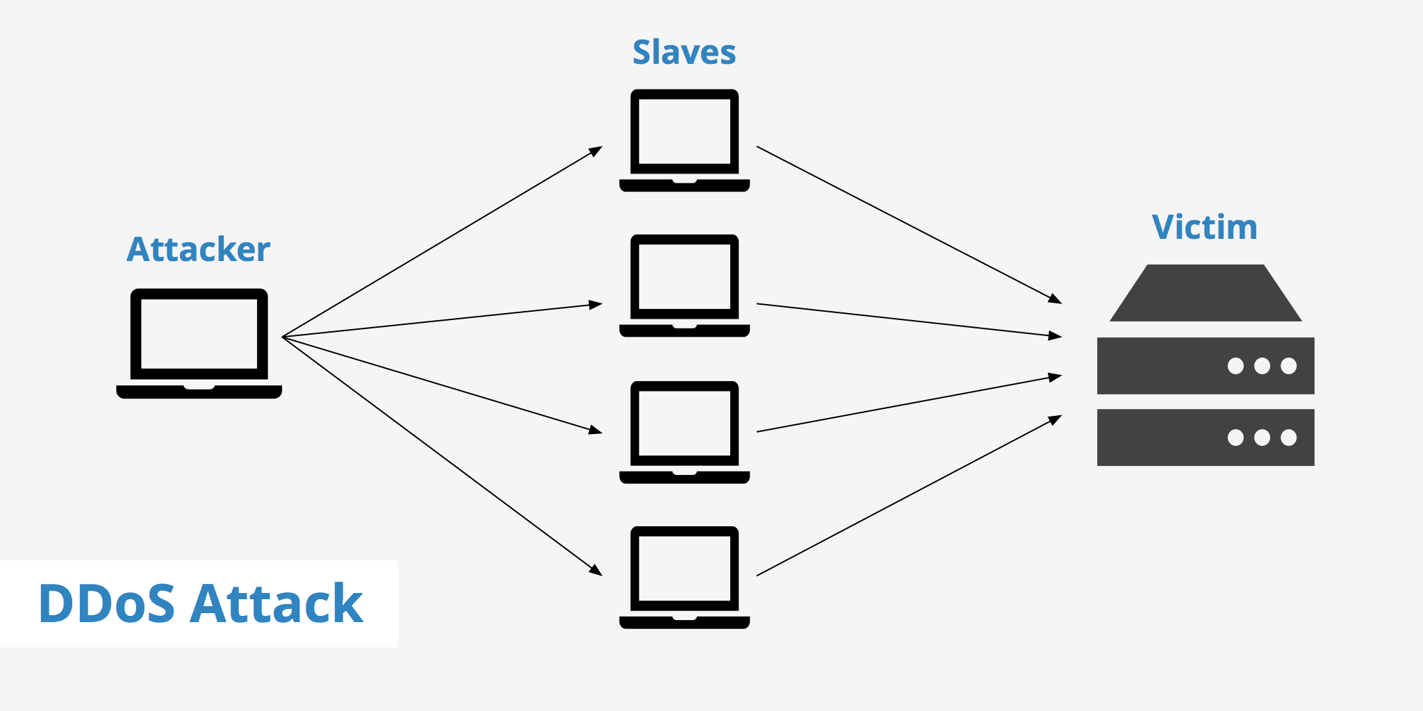
The Main idea
The main idea of the architecture is to monitor the frequency of HTTP requests in the form of invocation frequency of a serverless function that bridges the Web server and the Internet. If the invocation frequency goes above a threshold, it sets off an alarm, which triggers another serverless function to add high frequency requesters to a denial list.
Hypertext Transfer Protocol (HTTP)-based distributed denial-of-service (DDoS) attacks are extremely common and damaging to both on-premise and cloud-based Web servers.

Slide 12
Need for Prevention
Availability and Business Continuity: DDoS attacks can cause significant disruptions to online services, leading to unavailability of websites or network resources. For businesses, downtime can result in financial losses, decreased productivity, and damage to their reputation. By implementing preventive measures against DDoS attacks, organizations can ensure the availability of their services and maintain business continuity, reducing the impact of potential attacks.
Protection of Customer Trust: DDoS attacks can undermine customer trust and confidence in an organization's ability to provide secure and reliable services. Customers expect their data and interactions to be protected, and if they experience frequent disruptions or prolonged downtime, they may choose to take their business elsewhere.
Avoidance of Financial Impacts: DDoS attacks can have severe financial consequences. Organizations may incur costs related to mitigating the attack, including investing in specialized hardware, software, or cloud-based services.

Slide 13
04
Proposed Design →

Slide 14
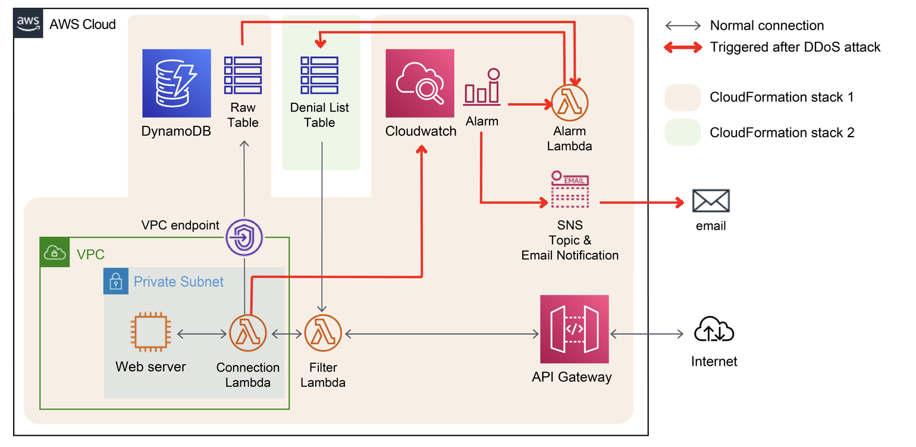

Slide 15
05
Working of Implementation
→

Slide 16
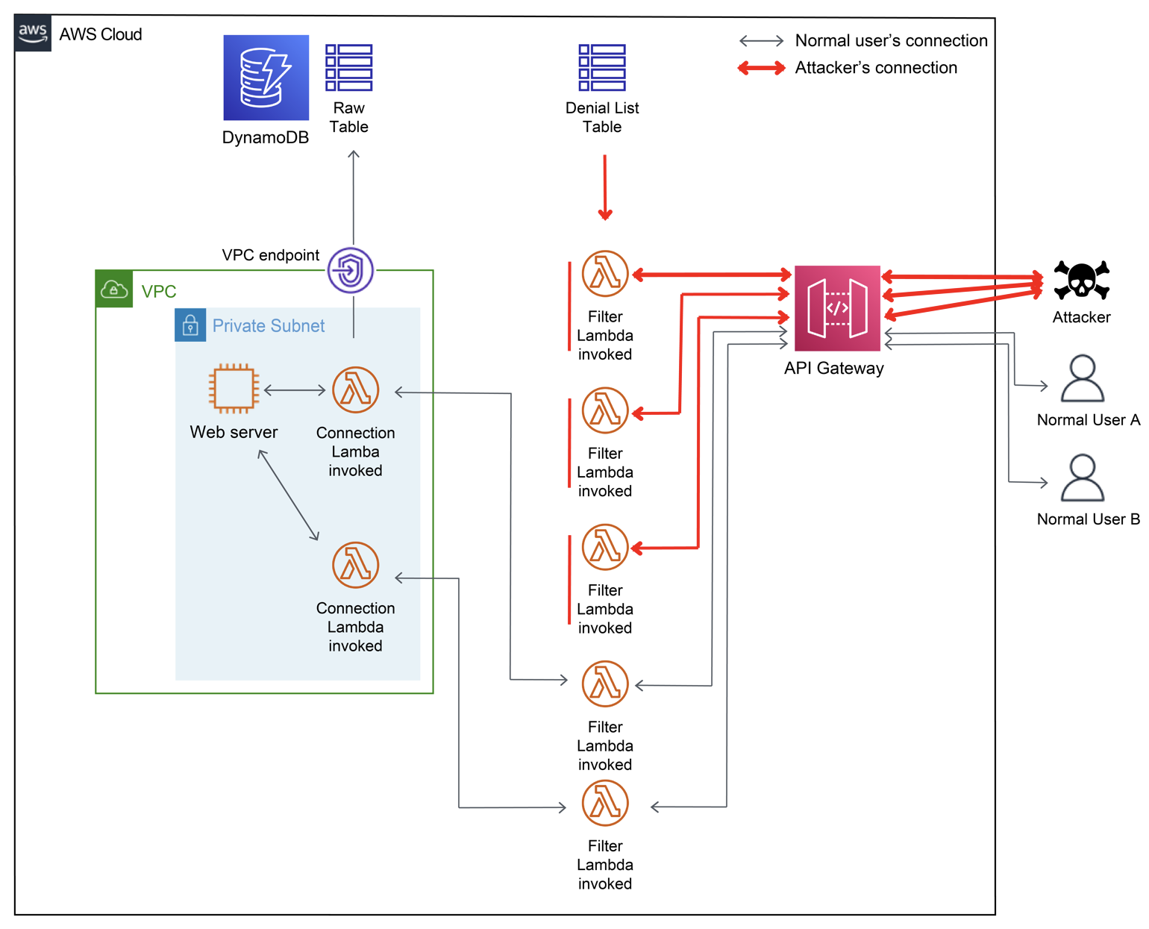

Slide 17
Normal Connection
Normal User Request: A legitimate user initiates an HTTP request from their device to access a web service.
API Gateway: The request is directed to an API endpoint created by the AWS API Gateway service. The API follows the REST style and supports HTTPS for secure communication.
Filter Lambda: For every request passing through the endpoint, the Filter Lambda function is invoked. It checks the request against a Denial List DynamoDB table to determine if the request should proceed.
Connection Lambda: After passing the filter check, the request is passed to the Connection Lambda function. Connection Lambda sends the request to the Web server instance located in a private subnet within a Virtual Private Cloud (VPC). Additionally, the request information is recorded in the Raw table of DynamoDB.
Response Flow: The response from the Web server travels back in the reverse direction. It passes through the Connection Lambda, Filter Lambda, API endpoint, and is finally returned to the user, ensuring a secure response flow.

Slide 18
Attacker’s Connection
Attacker Request: An attacker sends an HTTP request, similar to a normal user, to the API endpoint.
Filter Lambda Check: The request is intercepted by the Filter Lambda function, which checks the request against the Denial List DynamoDB table.
Denial List Check: If the attacker's IP address and user agent are not listed in the Denial List, the request proceeds to the Connection Lambda.
Connection Lambda and Web Server: The Connection Lambda forwards the request to the Web server instance within the private subnet of the VPC, just like in the normal connection scenario.
Alarm Trigger: If the invocation frequency of the Connection Lambda exceeds a threshold, an AWS CloudWatch alarm is triggered.
Alarm Lambda Response: The triggered alarm invokes the Alarm Lambda function, which parses the Raw table to identify high-frequency requesters. The identified requesters are added to the Denial List table.

Slide 19
Attacker’s Connection
7. Denial of Attackers: As a result of the alarm response, requests associated with high-frequency attackers are blocked from reaching the Web server instance. However, normal user requests remain unaffected.
8. Continuous Monitoring: If the attacker continues the DDoS attack by bombarding the endpoint with different source IP addresses and/or user agents not yet listed in the Denial List, those requests can be captured in the next alarm cycle. The CloudWatch alarm typically takes a few minutes to trigger after high-frequency invocations start.
9. Iterative Blocking: The process of identifying and blocking high-frequency attackers through the Alarm Lambda and Denial List table may require several rounds, depending on the number of IP addresses and user agents used, their frequency of change, and how they are distributed over time.

Slide 20
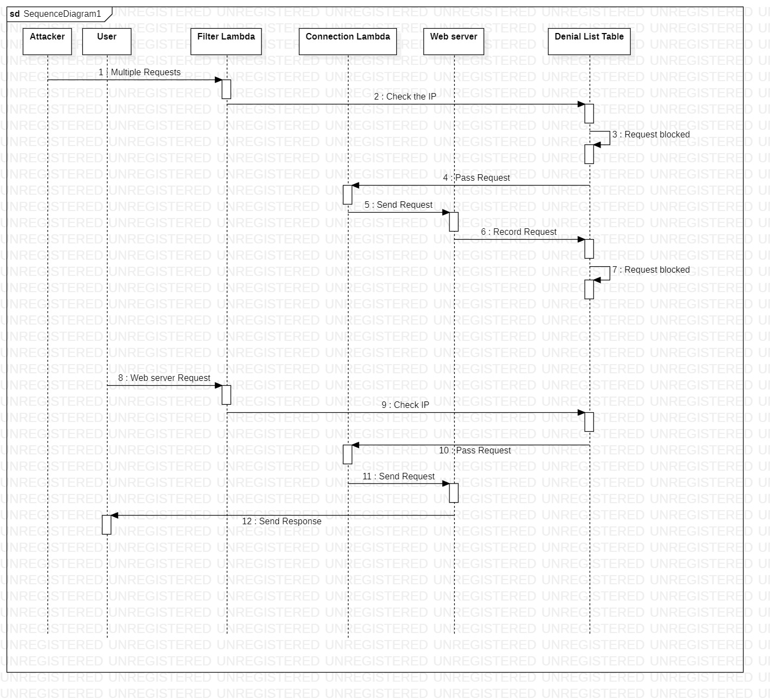
Sequence Diagram

Slide 21
06
Future Scope →

Slide 22
Future Scope 1: Approval List
An additional enhancement for the project could be the implementation of an approval list, which would override the denial list. This feature would be beneficial as it allows known users to bypass the denial list, preventing them from triggering alarms unnecessarily. In case a legitimate user is mistakenly added to the denial list, an administrator would have the capability to manually add them to the approval list, ensuring uninterrupted access for trusted users.
Future Scope 2: Expanded Request Information
To enhance the system's capabilities, the architecture can be extended to support additional request information beyond just the source IP address and user agents. For instance, specific paths or parameters of the requests could be included in the combination used for identification and filtering. This expansion would provide a more comprehensive and nuanced approach to differentiate between normal user connections and potential attackers, enhancing the system's accuracy and effectiveness in detecting and mitigating DDoS attacks.

Slide 23
07
TimeLine →

Slide 24
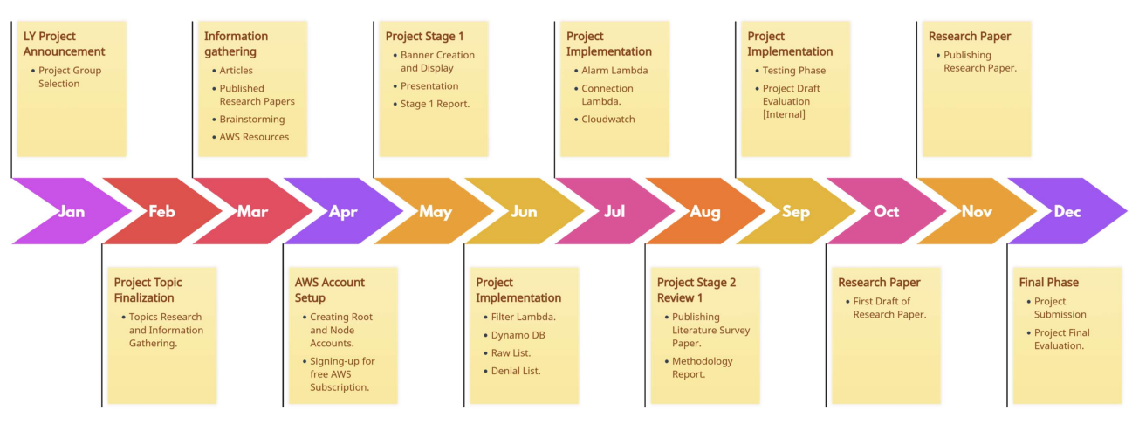

Slide 25
08
Demo →

Slide 26
Thank You!!

